Slide 1



MEDPATHAI:
An Interpretable Diagnostic Agent with Multilingual and Voice-Enabled Input Using Chain-of-Diagnosis Framework

Slide 2

Project Overview
Title:
MedPathAI: Enhancing Interpretable Diagnostics with Chain-of-Diagnosis (CoD)
Problem Addressed (The Gap):
Traditional LLM diagnostics lack interpretability , rely heavily on synthetic data (synthetic-to-real gap) , and exclude users due to text-only interfaces and language barriers (modality/accessibility gap).
Core Solution:
MedPathAI is an enhanced diagnostic agent that grounds the original Chain-of-Diagnosis (CoD) framework on real-world clinical dialogue data (MedDialog) and integrates a multilingual voice interface.
Key Innovations:
Validated CoD on Real Data: First validated implementation of CoD on real-world clinical dialogues, bridging the synthetic-to-real gap.
Entropy-Driven Efficiency: Uses an entropy-reduction strategy to optimize symptom selection and minimize user inquiries (average 3.0 questions).
Accessibility:
Supports multilingual, voice-enabled input (5 languages).
Interpretable Output:
Provides a five-step reasoning chain and explicit confidence distributions for every diagnosis.
Result:
Achieved 71.2% diagnostic accuracy on real-world data with improved efficiency

Slide 3
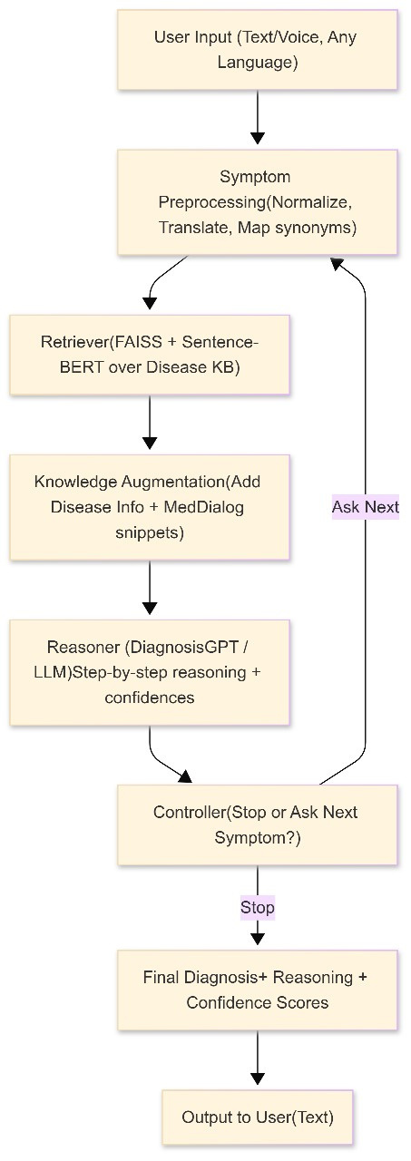
Architecture diagram
1. User Input: Receives Text/Voice in Any Language for accessibility.
2. Preprocessing: Normalizes symptoms via Language Detection and Auto-Translation to English.
3. Retriever: Identifies top-K candidate diseases using Hybrid Retrieval (BM25 + Dense Embeddings).
4. Knowledge Augmentation: Grounds reasoning by adding information from the Disease KB and MedDialog (real-world data).
5. Reasoner: Executes CoD steps, performing Diagnostic Reasoning and Confidence Assessment.
6. Controller: The decision block: Diagnoses (Stop) or Inquires (Ask Next). Uses Entropy Reduction to select the most informative next symptom.
7. Final Diagnosis: Compiles the complete, interpretable prediction, reasoning, and confidence scores.
8. Output: Delivers the final report, potentially in the user's native language.

Slide 4

Technology Stack and Tools
Programming language used:
Python (Primary language for the entire system, including the backend logic and the Streamlit frontend).
Libraries/Frameworks:
Large Language Model (LLM): Qwen2.5-7B-Instruct (Base model for MedPathAI).
Fine-tuning: LoRA (Low-Rank Adaptation) was used for efficient training.
Retrieval: FAISS (Index for dense vector search), Sentence-BERT / all-mpnet-base-v2 (for dense embeddings), and BM25 (for Hybrid Retrieval).
Frontend/UI: Streamlit (Used to build the interactive Clinical Dashboard).
Utility: langdetect, deep_translator (for Multilingual support/Translation), and streamlit_mic_recorder (for Voice Input).
Development Tools:
Python development environments (e.g., VS Code, Jupyter) are implied.
Training utilized a GPU server with NVIDIA A100 GPU cards.
Databases/Storage solutions:
Disease Knowledge Base (KB): Comprehensive database covering 9,604 diseases.
Vector Database: FAISS index stores the vector representations.
Datasets: MedDialog (Real-world dialogue data for validation) and DxBench (New diagnostic benchmark).
Deployment platforms :
Implies a Web-based Deployment for the interactive dashboard using Streamlit.

Slide 5


Mathematical Foundation
Core Mathematical Formulas
1. Shannon Entropy (H(c)) : Quantifies the current diagnostic uncertainty or diversity of the confidence distribution C.
H(C)=-ΣCdlog(cd)
d∈D
2. Entropy Reduction for Inquiry Selection: The system selects the next symptom () by maximizing the expected reduction in uncertainty (information gain).
st=argmax(H(C)-EY~P(y|s)[H(C|s,y)])
s∈S
3. Hybrid Retrieval Score: Combines lexical (BM25) and semantic (Dense) matching for efficient candidate recall.
scorehybrid (d,s) = α . scoredense (d,s) + (1-α ) . scoreBM25 (d,s)

Slide 6
Mathematical Foundation
Algorithm Explanations
1. Decision Making (Controller): Determines the next action (Diagnose or Inquire) based on the maximum confidence (Cmax) and a threshold ( 𝜏 )
{
_
_
Diagnose(dmax ) , if Cmax > 𝜏 and ning > 3
Anext =
Inquire(St ) , otherwise
2. Confidence Calculation: The model generates confidence scores, viewed as a softmax distribution over candidate diseases.
exp(scored / 𝜏temp)
cd =
Σexp(scored’ /𝜏temp)
d’∈D

Slide 7
LIVE DEMO

Slide 8

Improvement on the paper
Core Improvements
Real-World Validation: First CoD implementation on real clinical dialogues (MedDialog), resolving the synthetic-to-real data gap.
Efficiency: Implemented Entropy Reduction for smart question selection, reducing average inquiries by 29% (to 3.0 rounds).
Accessibility: Integrated multilingual voice interface supporting five languages (English, Hindi, Spanish, French, Mandarin).
Performance Summary
Overall Accuracy: Achieved 71.2% (higher than DiagnosisGPT v3.3 at 69.8% and Original CoD at 68.5%).
Real Data Accuracy: 67.1% (demonstrates generalization from synthetic data's 72.4%).
Efficiency: Average inquiries of 3.0 rounds (significantly lower than the CoD baseline of 4.2).
Challenge & Resolution
Challenge: Integrating the structured CoD framework with ambiguous, real-world MedDialog conversations.
Resolution: Used Hybrid Retrieval and Knowledge Augmentation (with real snippets) to ground the LLM's reasoning.
Future Focus
Limitations: Limited Handling of Rare Diseases and Not Clinically Validated.
Extensions: Expand to support low-resource languages, integrate with EHRs, and use Advanced Reinforcement Learning for question selection.

Slide 9

THANK
YOU

